Slide 1

Two Public Histories of Housing Discrimination in Connecticut
Jack Dougherty, Professor, Trinity College
June Gold, Esq.
David K. Ware, Attorney
Sabrina Buckwalter, Producer,
Connecticut Public

Slide 2
Two Public Histories of Housing in Connecticut
Part 1:
Part 2:
How to find and reject racist covenants in Connecticut Town Land Records
myCTdeed.com
Fighting for Home: How Housing Policy Keeps Connecticut Segregated
Airs 6/27 !

Slide 3
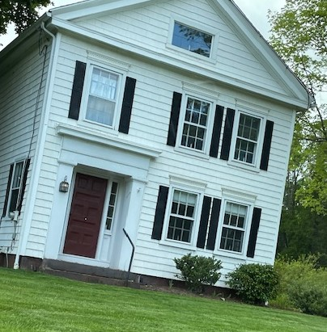
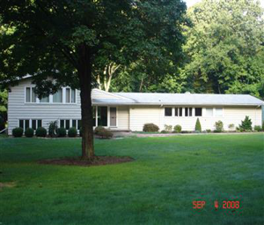
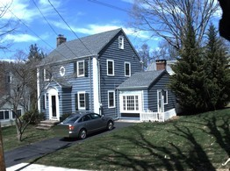
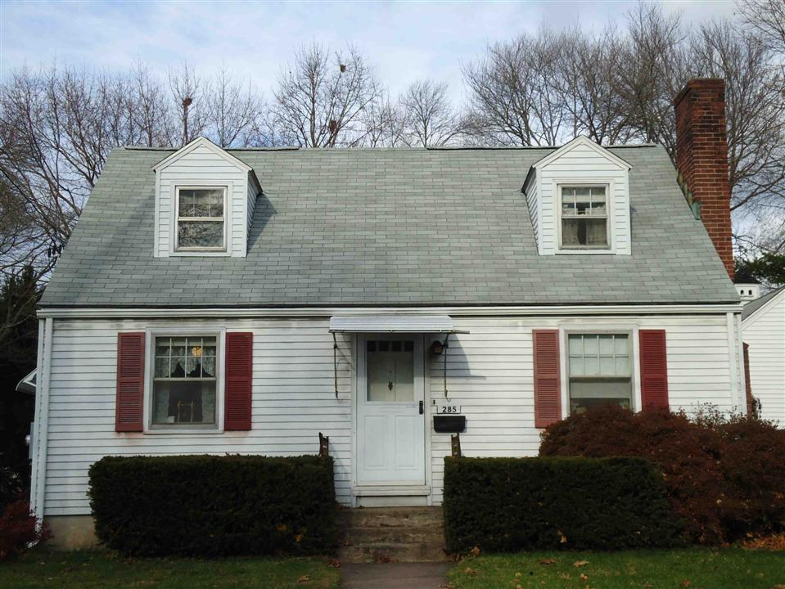
These Connecticut homes have something in common…
Cheshire 1790
Covenant added later
Woodbridge 1958
“No persons of any race other than the White race shall use or occupy any building or any lot, except that this covenant shall not prevent the occupancy by domestic servants of a different race domiciled with an owner or tenant.”
Hamden 1941
Manchester 1949
Notes:
June slide 1, or this could be an introductory slide (Jack)

Slide 4

Reading Connecticut Land Records
Documents to Look For:
Agreements Warranty Deeds
Schedule A
Notes:
June 2
Quit claims are usually not complete, however here is an exception.
Read everything. Look in the body of the text. Look in Schedule A.

Slide 5


A Typical Homeowner Deed Search Tracing the Land Record Back in Time
Current Homeowner
Previous Conveyance
Previous Conveyance
Current Owner is the GRANTEE
Seller is the GRANTOR
Previous owner is now the GRANTEE
There is a prior GRANTOR
Previous owner is now the GRANTEE
There is a prior GRANTOR
Earliest Land Record
Present
Day
Previous Conveyance
Previous Conveyance
Previous owner is now the GRANTEE
There is a prior GRANTOR
Previous owner is now the GRANTEE
There is a prior GRANTOR
Notes:
June 3 (Only a few seconds to contrast what we are doing with a typical homeowner search or title search.)

Slide 6

Working With Physical Records
Where to Begin?
Everything is part of the public record.
Known covenant – research the surrounding neighborhood or other homes with the same developer.
Use maps to begin – then research those developments.
Finding names – use property cards or the town tax database.
Browse volumes that contain documents in the relevant years.
Go down the rabbit hole any way you can! Some of this is intuitive.
READ EVERYTHING after looking up the property. The deed history of a home is the complete record, not just a snapshot.
A covenant may be found “buried” in the document, or referred to in Schedule A.
Notes:
June 4
No FIOA necessary
Re: known covenants; ask housing activist groups
Developer maps may not be in chronological order. Clerks are helpful.
CT land records are indexed by name. Sometimes warranty deeds are in separate volumes.
“Volume browsing” is a good method for smaller towns and where warranty deeds are in separate volumes.
Whether physical or online, take vision breaks! Look up and focus on something in the distance!

Slide 7

Working Online
Juggling the Tools of Online Covenant Research
Some towns have robust land records online.
Open the Lands Records database for the town you are searching.
Open the GIS map for the town you are searching.
Click on a neighborhood and plot. Open the property card in a separate window. Search the volumes and pages listed on the card.
Be aware of private transactions; more research is needed
Quit claim deeds are often incomplete; more research is needed
Other conveyances (inheritances, gifts, recorded on statutory forms, etc.)
Some property cards have a fuller record of conveyances and recordings
Notes:
June 5
Take a moment to become familiar with the property card style for that town.
Woodbridge: 68 Wepawaug
GIS:
https://woodbridge.mapxpress.net/ags_map/
Woodbridge Land Records:
762/255 → 52/107 → 44/308
https://i2g.uslandrecords.com/CT/Woodbridge/D/

Slide 8

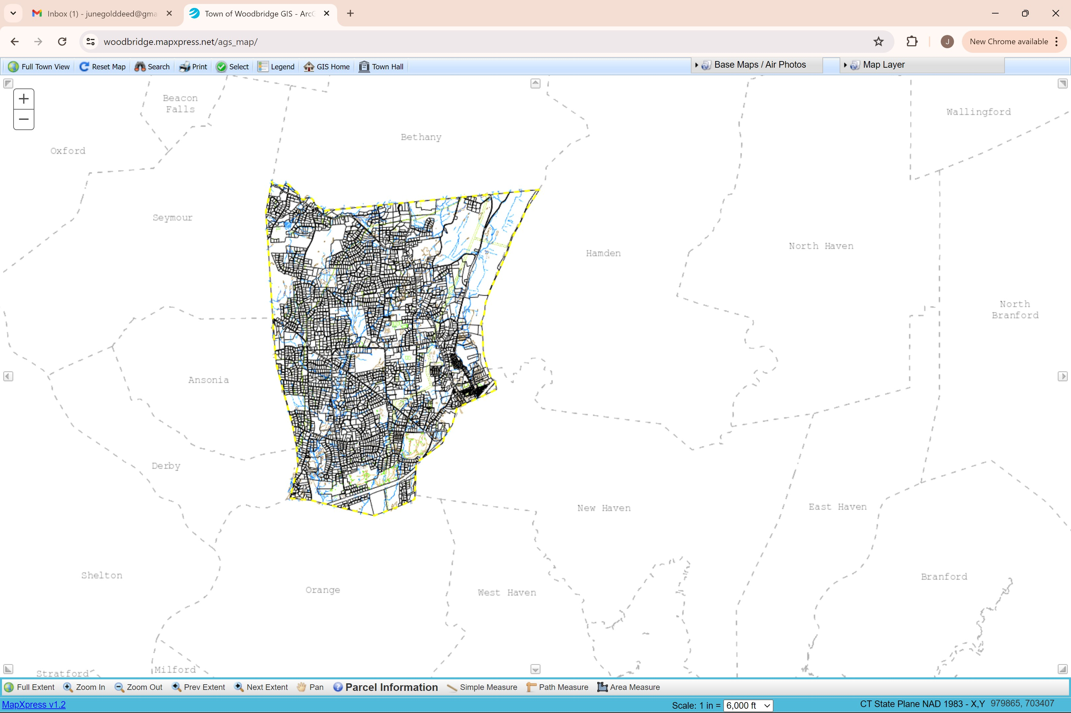
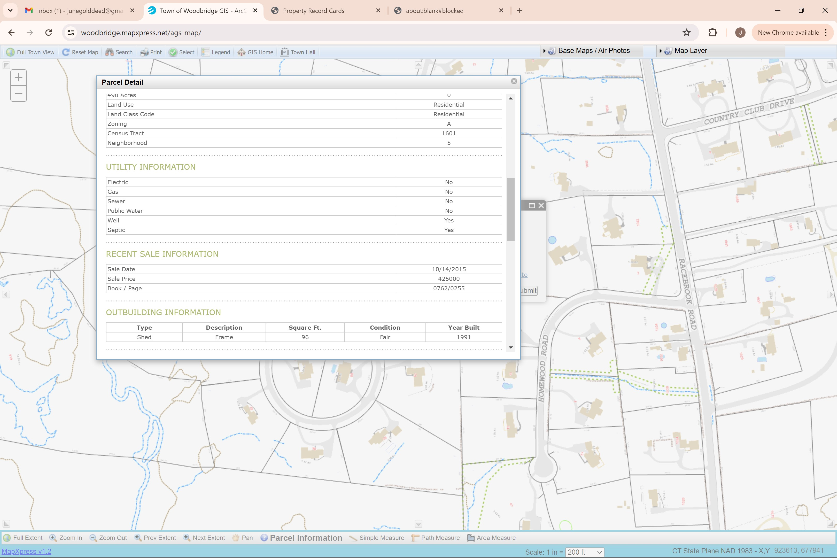
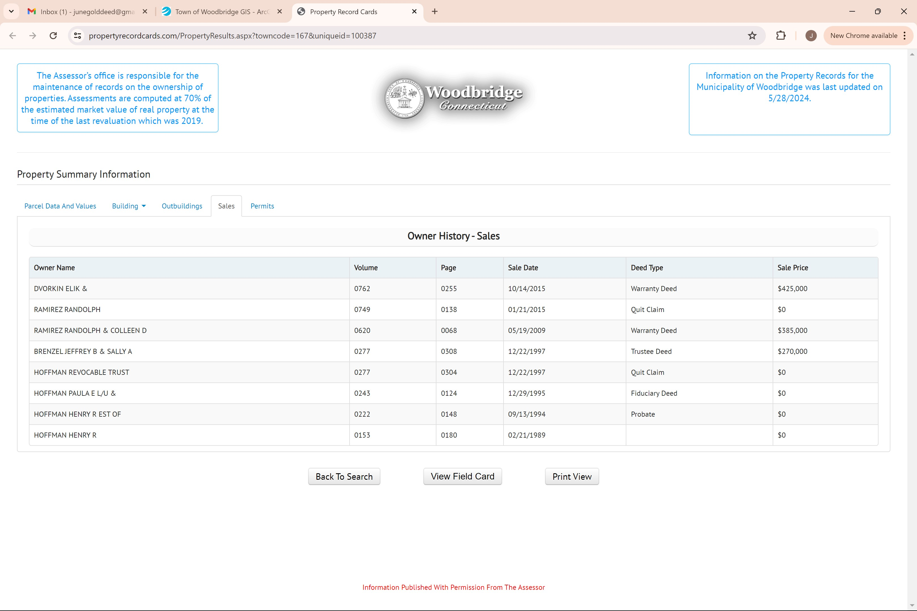
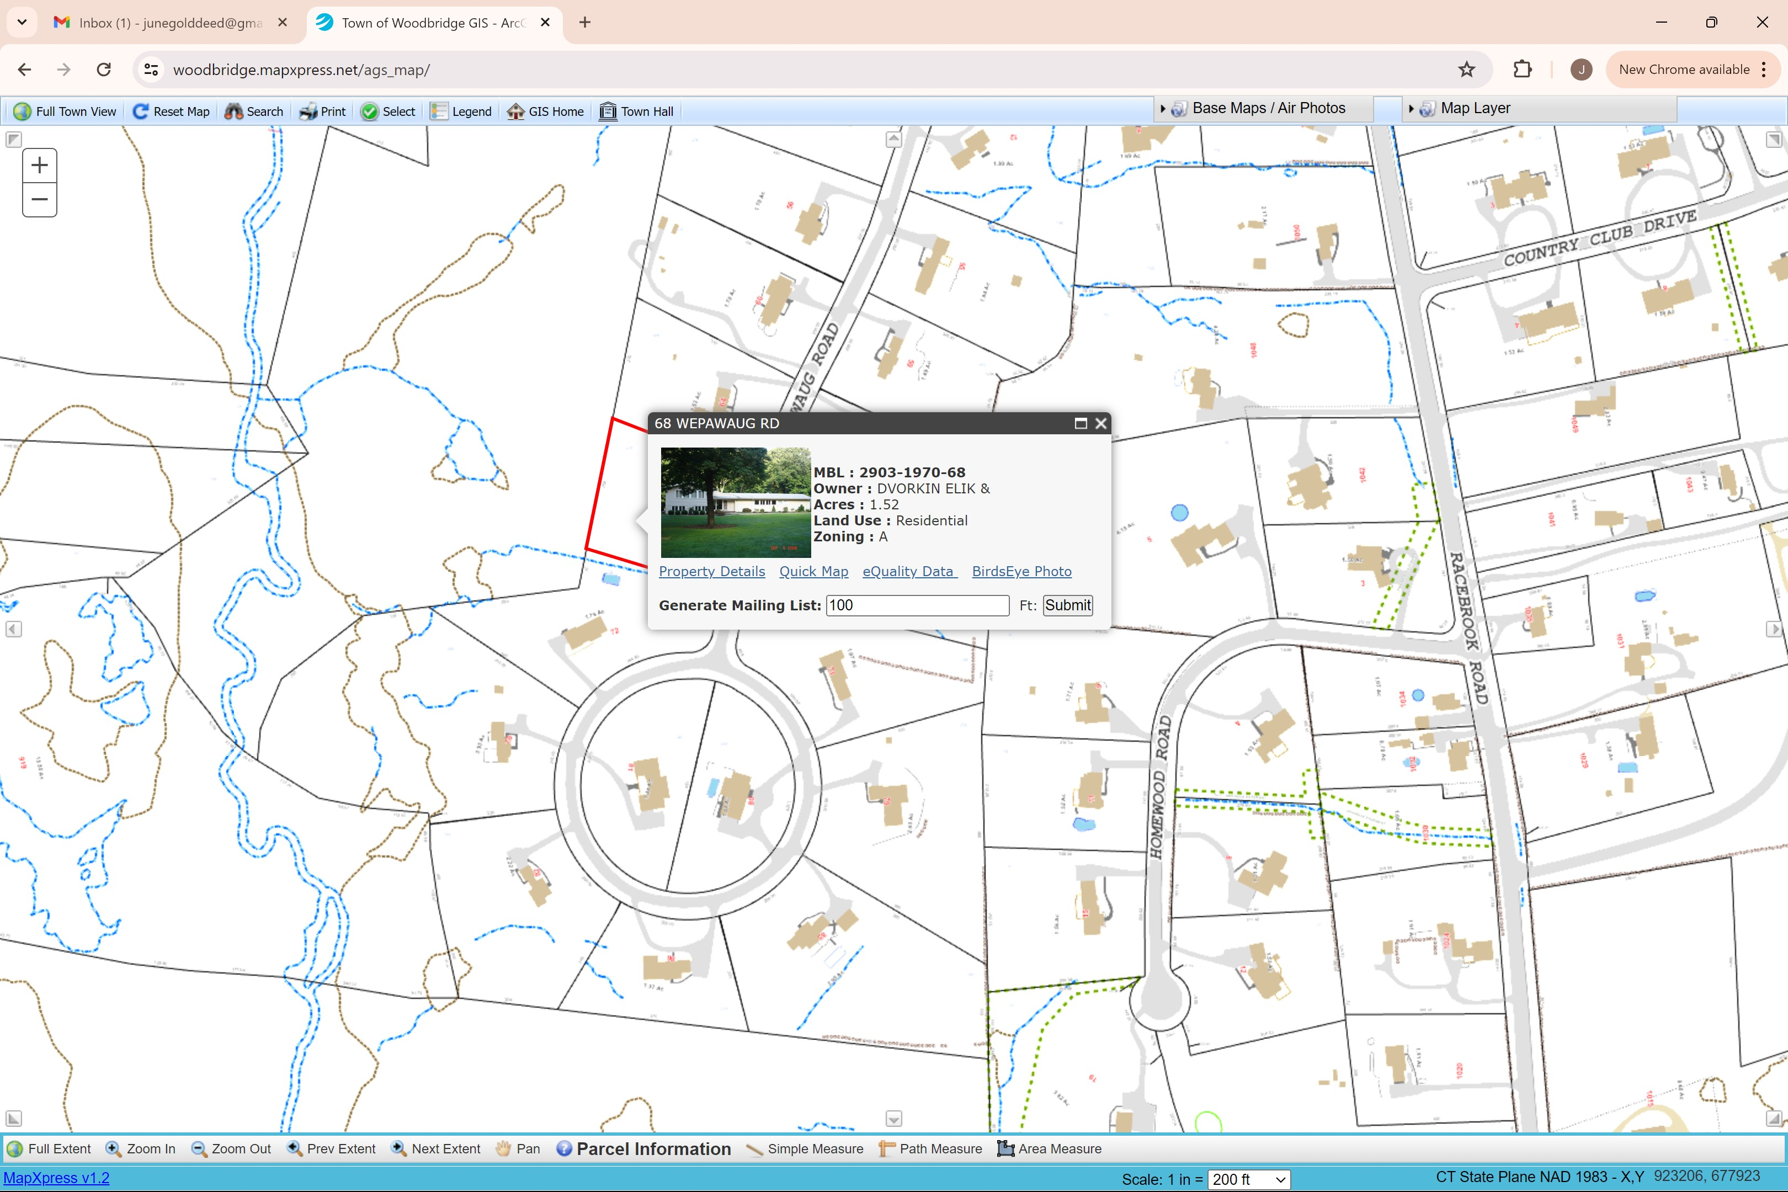
68 Wepawaug Rd.
Notes:
June 5A

Slide 9

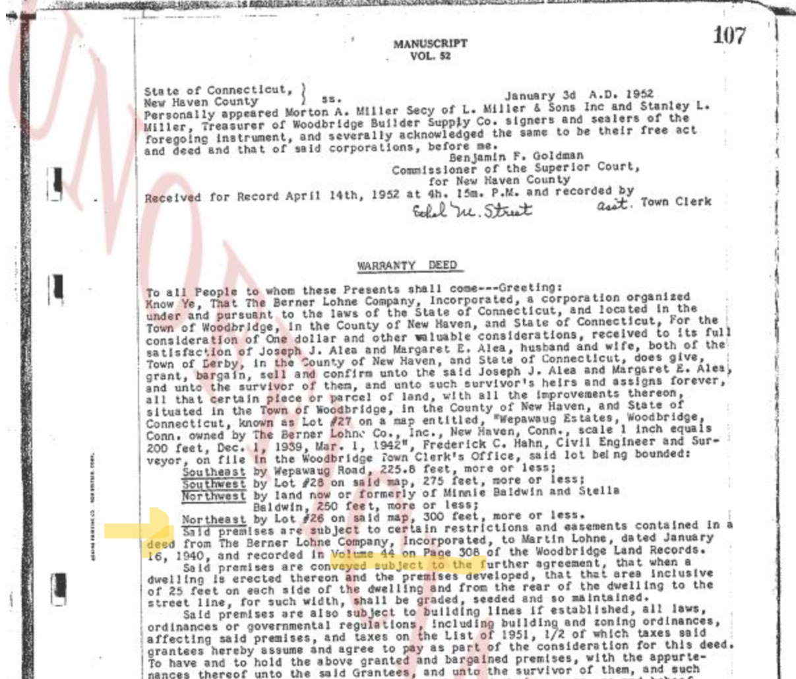
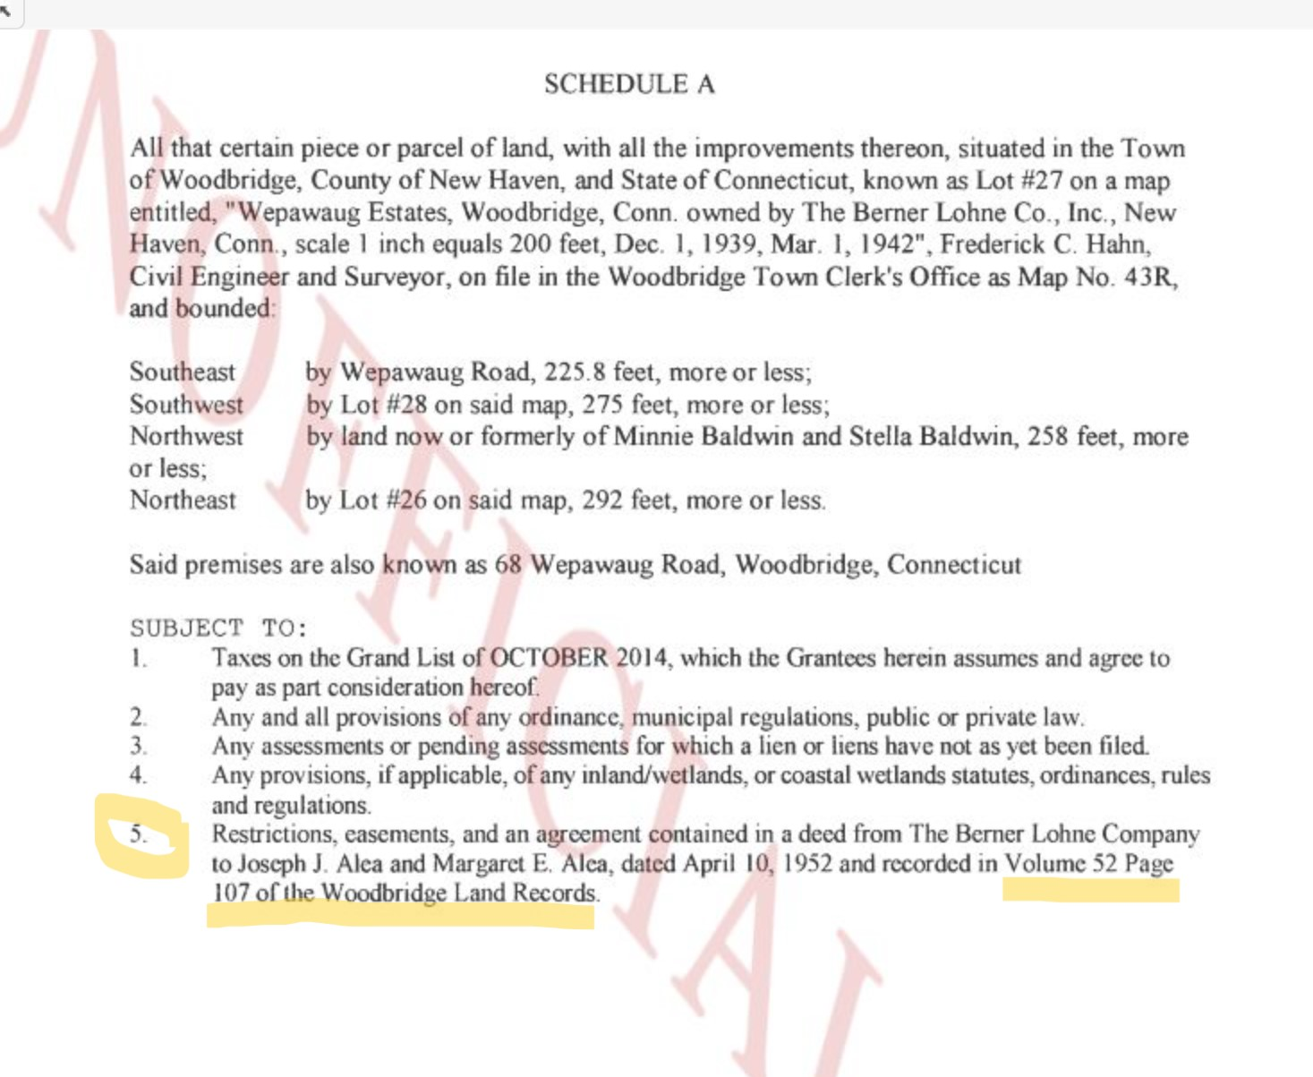

68 Wepawaug Rd.
Vol.762 Pg. 255
Notes:
June 5B
Example of reference in Schedule A.
Example includes reference near beginning of Warranty Deed. Note how multiple documents are on one page.

Slide 10


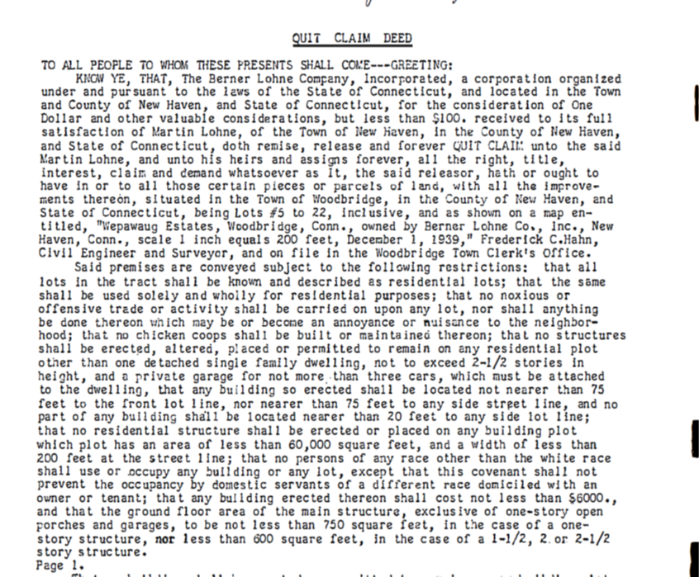





68 Wepawaug Rd.
Notes:
June 5C

Slide 11

Tips and Tidbits
An agreement might exclude certain plots, however home-specific research may show that the restrictive covenant was later included.
Remember, databases are searchable by name, which can be a homeowner, developer, or name of a development. Use everything!
While generally homes with restrictive covenants were built in the 1920s – 1940s, be aware that covenants run with the land. Newer homes may have been built on razed plots that are racially covenanted.
Make a grid of a town and sample each section.
Take a bird’s eye approach! What do you know about this town’s history? Do the shapes of the neighborhoods on the GIS map provide clues?
A town’s taxpayer database is a good source for finding names.
Developers touted “exclusivity” in newspaper ads. These sources may lead to results.
Notes:
June slide 6
Example: 1790 home in Cheshire
I will obtain a free map of a town and mark the areas I’ve searched.
Both GIS and a paper map can be helpful.
Also, you may find a life tenancy. We believe a life tenant may renounce by affidavit.

Slide 12
Legal Background
In Corrigan v. Buckley (1926): Supreme Court decides racial restrictions are constitutionally permitted; 14th Amendment does not limit actions of private individuals
Consistent with other court decisions like Plessey v. Ferguson (separate but equal) and with a general prevalence of segregation practices during “Jim Crow” era
In CT, racially restrictive covenants appear to peak late 30’s to late 40’s
Notes:
Dave 1

Slide 13


Shelley v. Kraemer (1948)
SUPREME COURT DECIDES ENFORCEMENT
OF RACIALLY RESTRICTIVE COVENANTS
VIOLATES EQUAL PROTECTION CLAUSE OF
14TH AMENDMENT
Unenforceable
14th AMENDMENT CONCERNS GOVERNMENT ACTIVITY,
SO ENFORCEMENT, I.E. USE OF THE JUDICIAL MACHINERY
OF THE STATE, TO UPHOLD UNEQUAL TREATMENT OF
RACES, IS UNCONSTITUTIONAL
Unconstitutional
COVENANTS THEMSELVES ARE NOT HELD
TO BE ILLEGAL OR VOID; NO MANDATE TO
FORBID OR REMOVE THEM
But still there…
Notes:
Dave 2

Slide 14
Land records still contain thousands of race-based covenants
BUT, IN LAND RECORDS
THEMSELVES, THE COVENANTS
REMAIN UNREFUTED. FOR
AFFECTED PROPERTIES, THEY
ARE THE LAST STATEMENT OF
RECORD CONCERNING
SEGREGATION
AFTER SHELLEY, FEDERAL AND
STATE FAIR HOUSING STATUTES
OUTLAWED SUCH PRACTICES –
NOW IT’S UNENFORCEABLE
AND ILLEGAL
Notes:
Dave 3

Slide 15
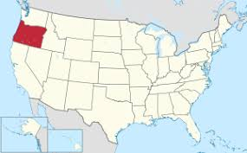
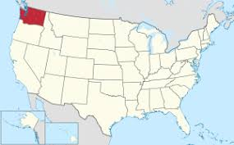
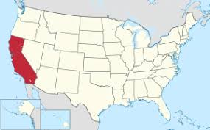
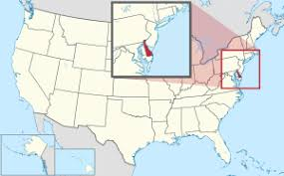
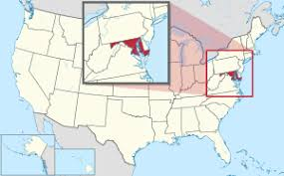
States Respond With Legislation
Oregon (2018)
Washington (2019)
California (2020)
Delaware (1973)
Maryland (2019)
Procedures are cumbersome and have limited effect
Notes:
Dave 4

Slide 16

Connecticut Public Act §21-173
Racially Restrictive Covenants are VOID
New PROCESS created for Renouncing Covenants in Land Records
Simple Forms: AFFIDAVIT; and “FORM”
Property Owner(s) Names(s)
Description
Volume/Page reference where covenant is found
A Rejection or Renunciation of the Covenant
NO Recording Fees
NO Encumbrance on the property
Notes:
Dave 5

Slide 17
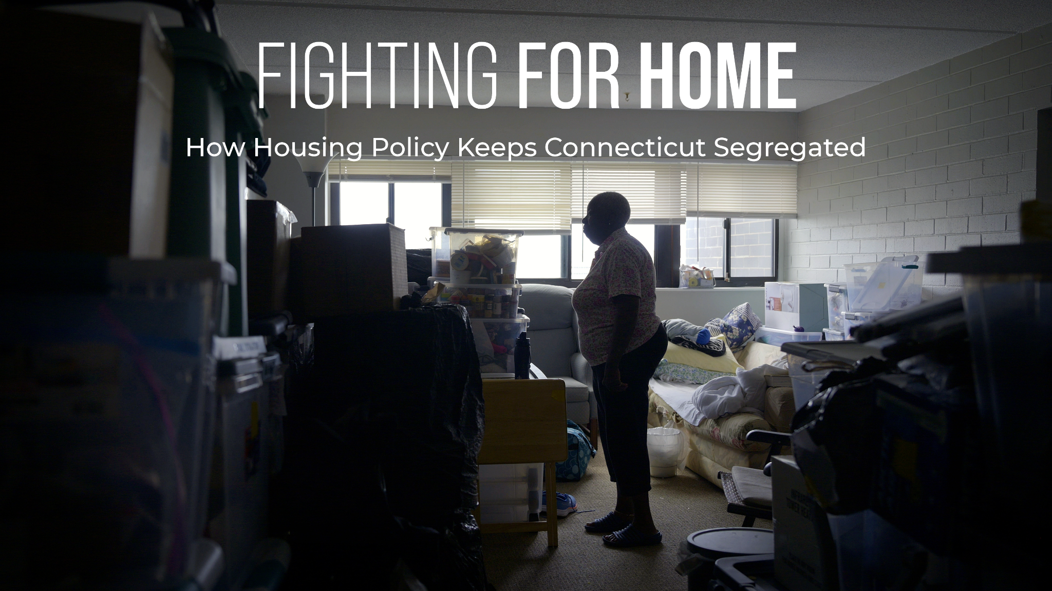



A film by Connecticut Public
Director Julianne Varacchi Story Producer Sabrina Buckwalter Editor Tyler Russell

Slide 18
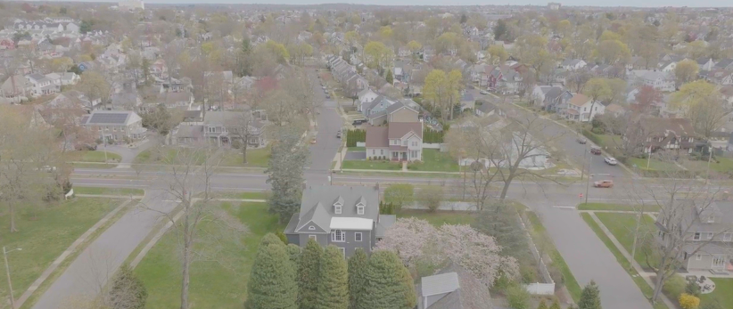


Bridgeport (small lots)
Fairfield (large lots)
Why housing?
Previous work on education inequity
Ranked worst state in the nation for renters
More housing is not enough; rise of tenant unions
CT hit highest numbers of homeless
Lowest vacancy rate in state 2022
Sixth overall in oldest housing stock

Slide 19
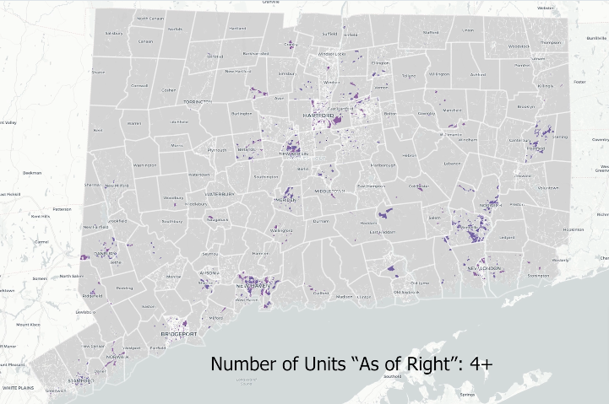
IF AN APPLICATION MEETS THE CRITERIA OUTLINED IN THE DISTRICT’S ZONING CODE, IT WILL BE APPROVED.
Credit: https://www.zoningatlas.org/atlas

Slide 20
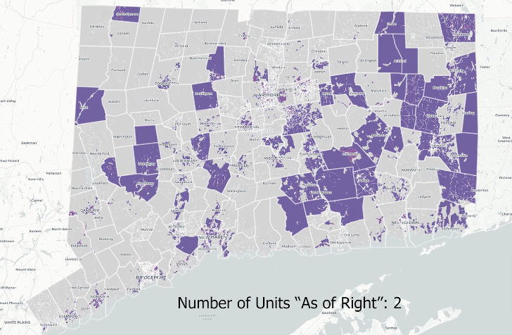
IF AN APPLICATION MEETS THE CRITERIA OUTLINED IN THE DISTRICT’S ZONING CODE, IT WILL BE APPROVED.
Credit: https://www.zoningatlas.org/atlas

Slide 21
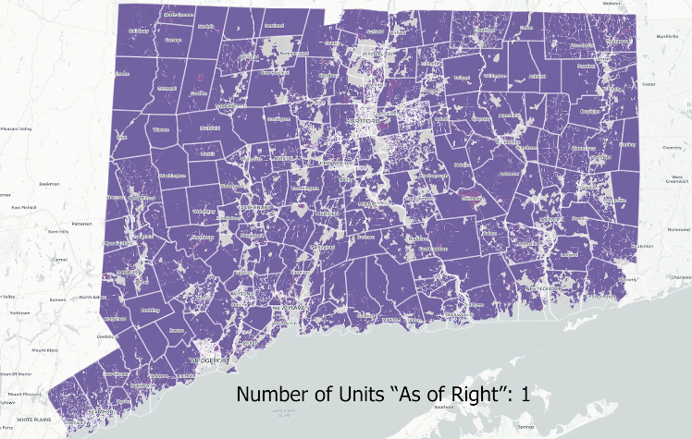
IF AN APPLICATION MEETS THE CRITERIA OUTLINED IN THE DISTRICT’S ZONING CODE, IT WILL BE APPROVED.
Credit: https://www.zoningatlas.org/atlas

Slide 22

Rep. Jason Rojas
“I think for all people across the spectrum, I think the conversation often happens in the context of low income people, but I think there are even middle income people and even upper middle income people who are really struggling with the cost of housing...I think it's something that gets taken for granted. We're comfortable in our housing, therefore that's the least of my problems.”
How many of you have ever
struggled with housing?

Slide 23
What can you do?
“In the UK, Ripon Museums have been working to help homeless people speak about their experiences. In 2018 the Workhouse Museum held an exhibition called ‘Homeless Not Faceless’. It ran in partnership with the Harrogate Homeless Project. The display featured stories and photographs of 12 people. They gave personal accounts of being homeless in their own words. When homelessness becomes a personal story, it helps audiences to engage with it.”
“Build relationships with the social service nonprofits in your area that work with people experiencing homelessness. You will not be able to work with all of them, and it’s okay to make choices. At the most basic level, they will help you understand the complexities of homelessness, how changes in local politics may impact this population and any other nuances that may be left out of press coverage. As the relationship develops, you may discover programs or institutional partnerships that can benefit both your institution and the social service agency.”

Slide 24


Thank you!
Jack Dougherty John.Dougherty@trincoll.edu
June Gold, Esq. JuneGoldDeed@gmail.com
David K. Ware, Attorney DaveWareDeed@gmail.com
Sabrina Buckwalter, CT Public SabrinaBuckwalter@ctpublic.org
myCTdeed.com

